Slide 1
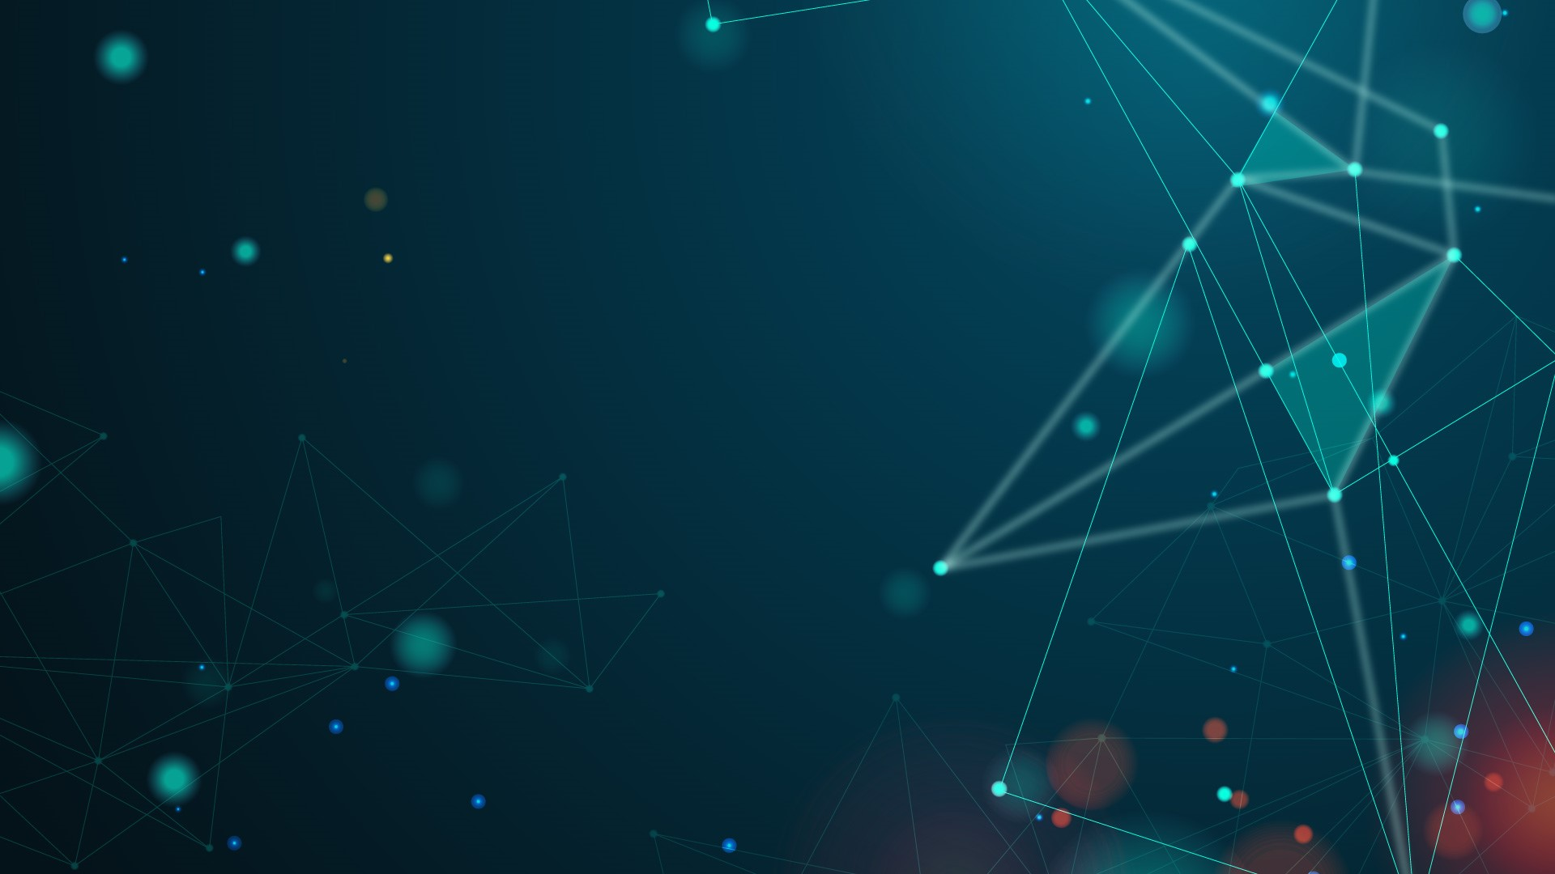

EECS 195: Colorization Using Deep Learning & Conditional Random Fields
Timothy Do, Matthew Prata, Jorge Radge, Alex Wang
March 10th, 2022
UC Irvine
Professor Yanning Shen

Slide 2
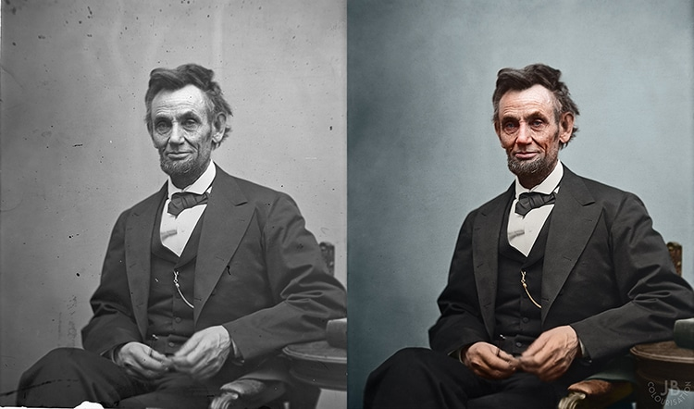
The Problem
Motivation: Colorizing images can be an extremely and time-consuming process. AI can provide simple and accurate solutions to this problem.
Problem: How can we plausibly colorize a grayscale image using Computer Vision and Neural Networks in an unsupervised manner? What type of model the best approach to this problem?
[1]

Slide 3
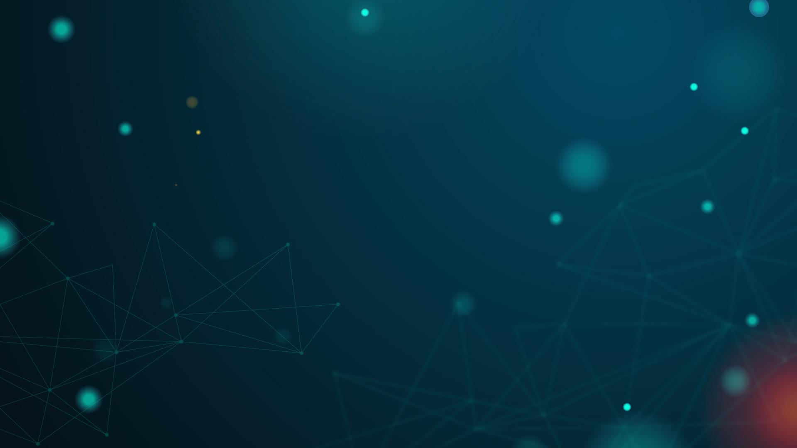
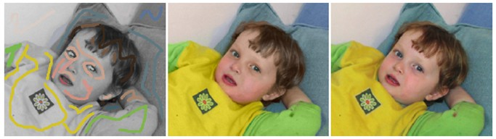
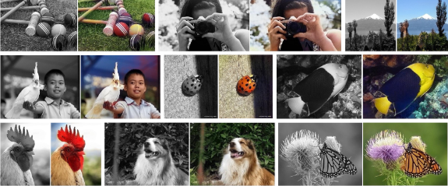
Contemporary Approaches
One approach is to have the user provide suggested colors using a scribble tool (left). The algorithm then produces a colorization (middle) on the feature that is scribbled on. For reference, the original image is also shown (right).
Another approach is to approach the problem as an unsupervised classification problem, where the classes are normalized to bin centers of the images. Left are the input images, right is the output.
[2], [3]

Slide 4
Programming Environment Libraries
Deep Learning training/Model Creation
Tensorflow + Keras
OpenCV/Matlab
Image Processing (Preprocess)
Preprocess/Input to model
Numpy/Sklearn
Matplotlib
Displaying Images and comparison

Slide 5
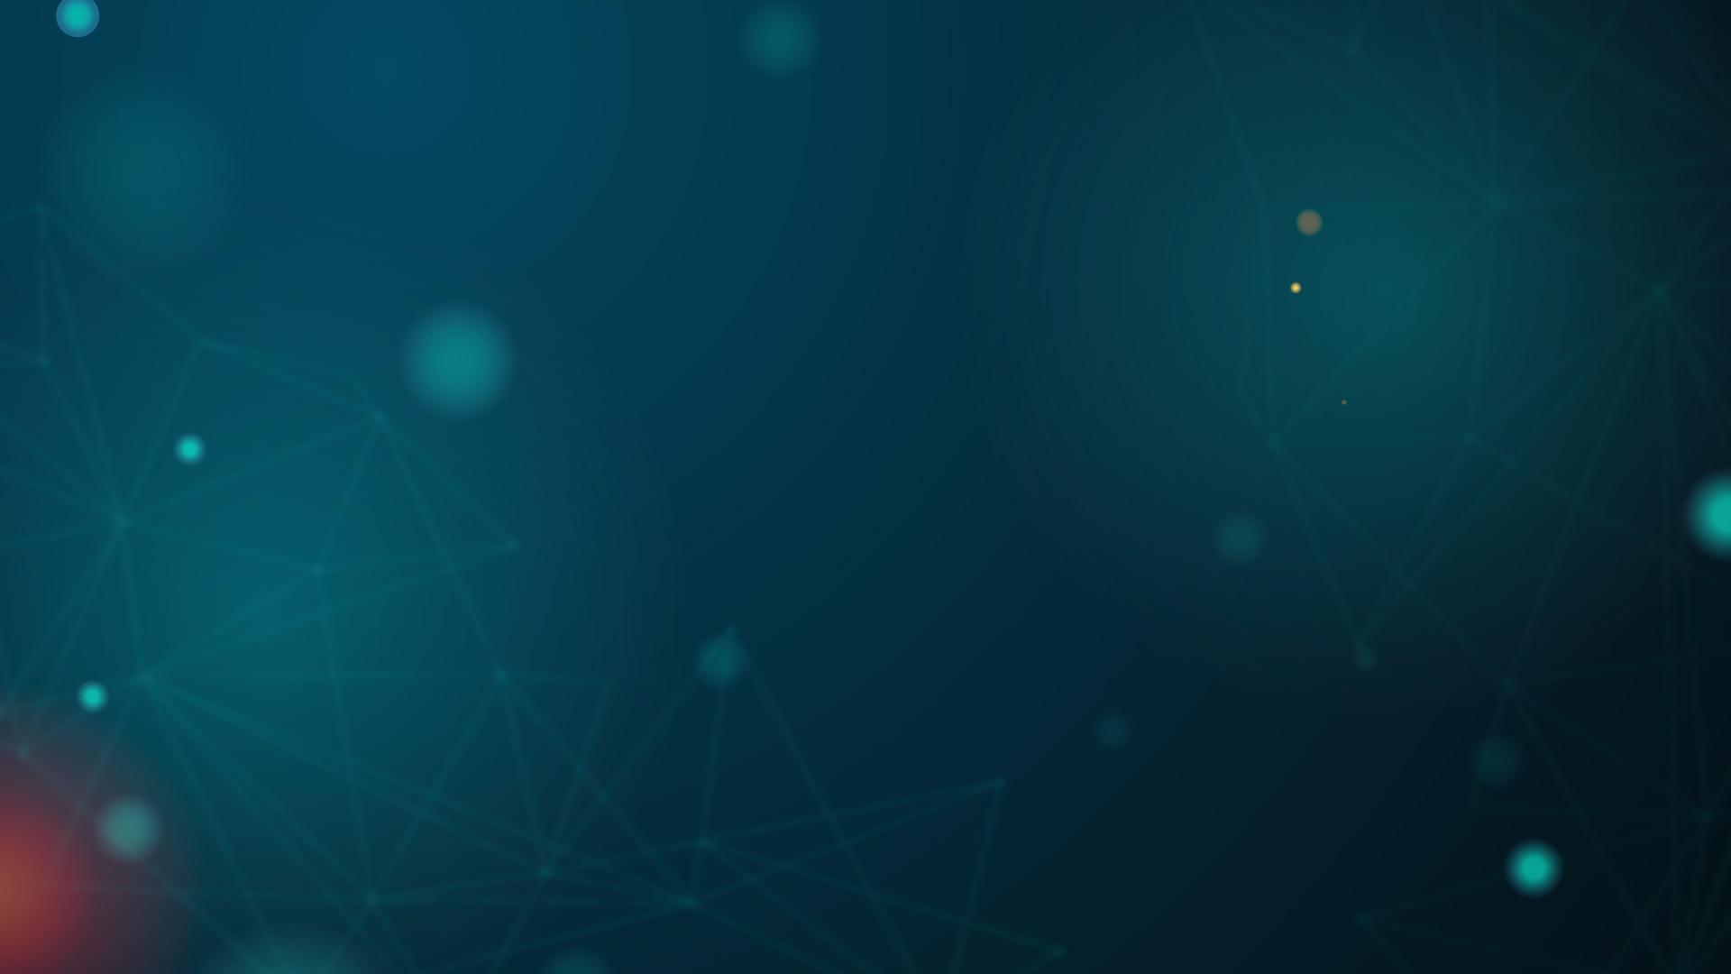
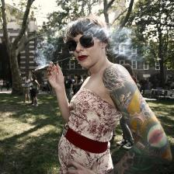
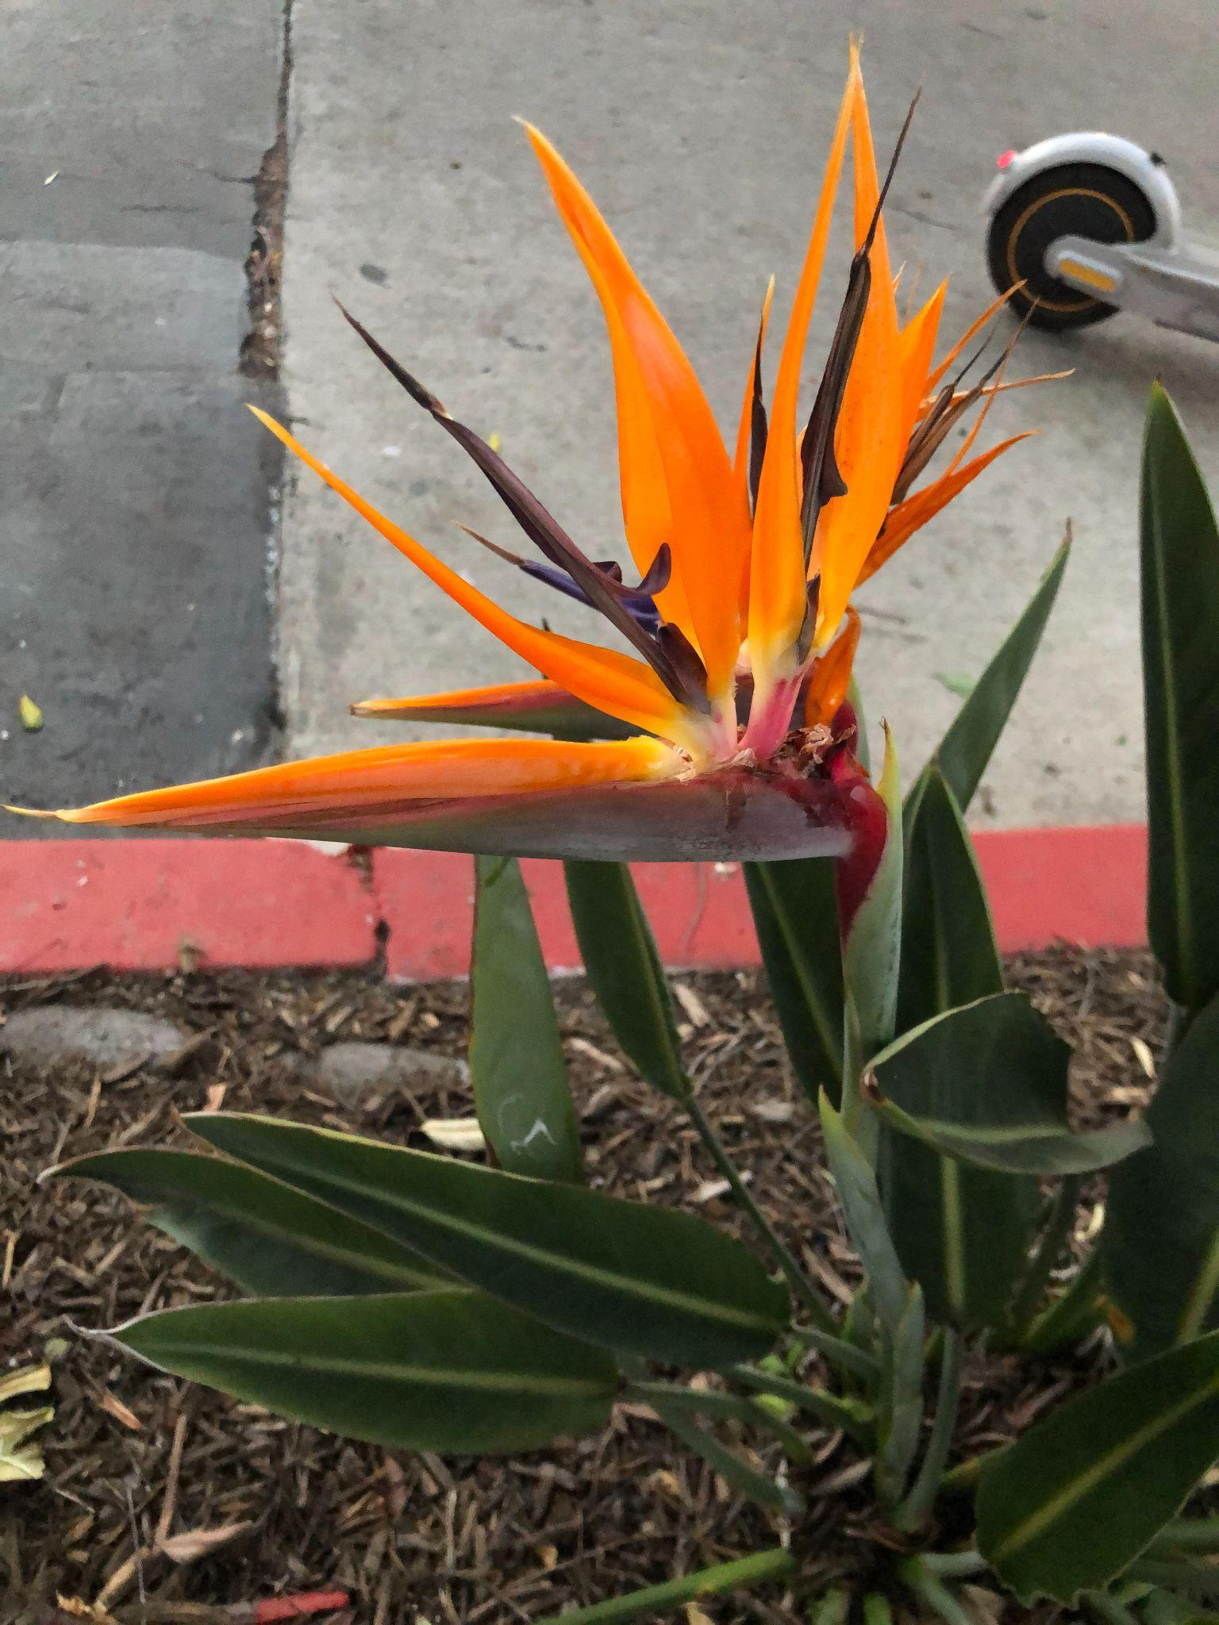
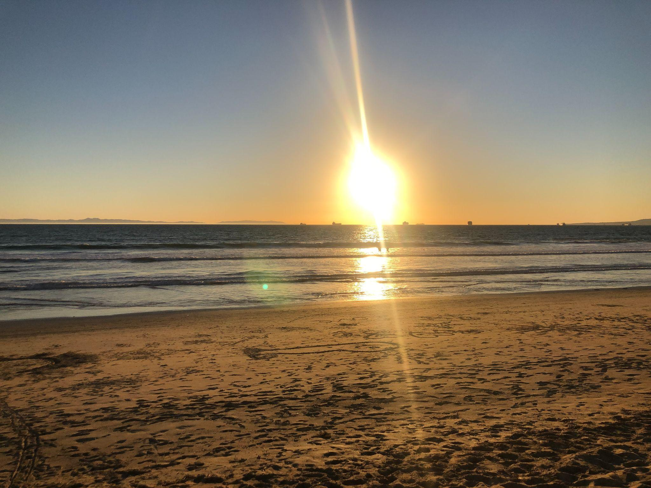
Data
Kaggle
Flowers
Beach Ocean
25,000 Images of Colorized and gray-scale
Personal data set of 500 flowers to train separate model
Personal data set of 700 images of the beach, ocean, clouds, sun
[4]

Slide 6
DataSet Preprocessing
01

Slide 7
Steps of Preprocessing
Downscaled image to set reasonable quality and drastically reduce computation time.
Segmented Images (Average scale color detection)
Convert all of the segmented images into L and ab color channels
Split the LAB matrices into L and ab numpy arrays

Slide 8
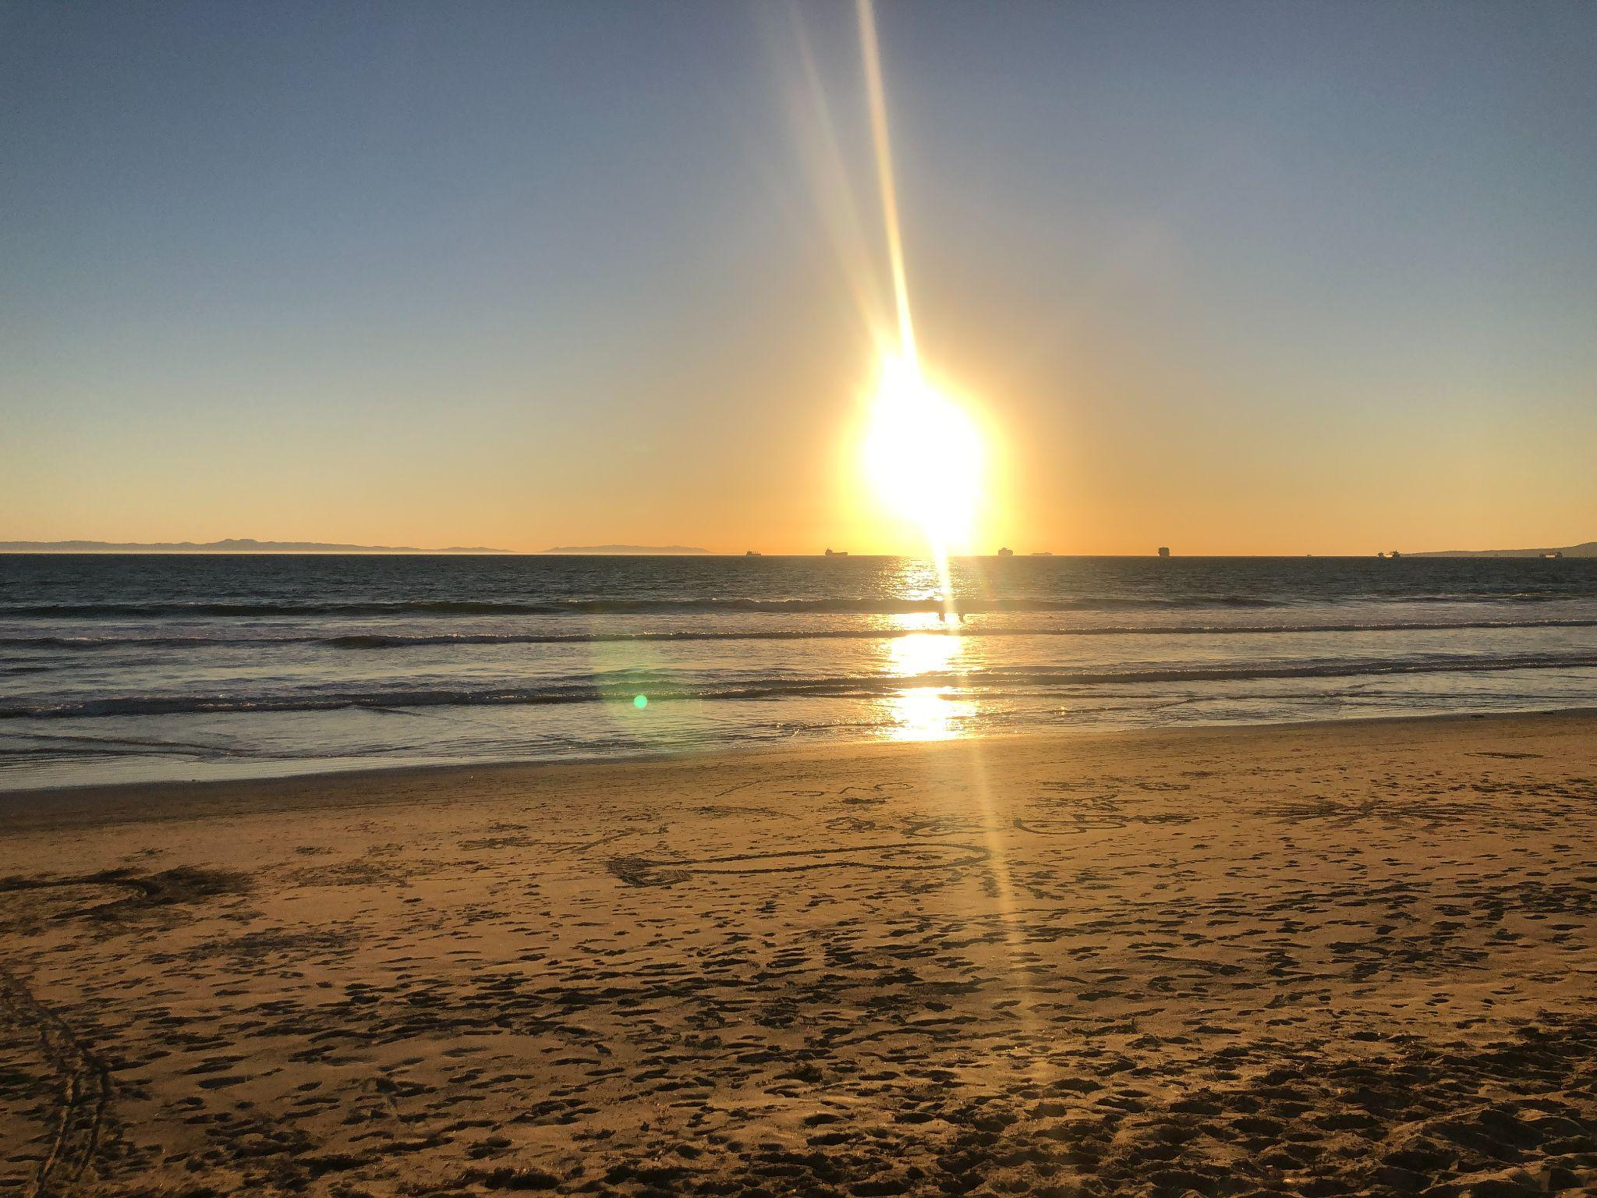
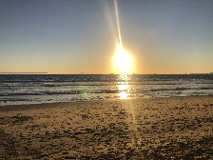
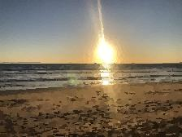
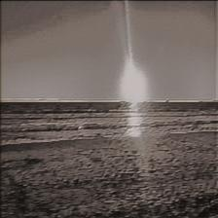
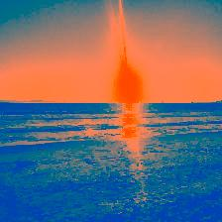
Preprocessing Visualization
Original
Downscaled
Segmented
Numpy Arrays (1 for L, 1 for ab)
LAB Format

Slide 9
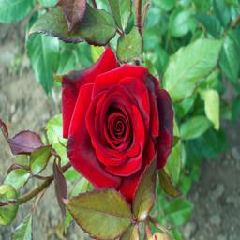
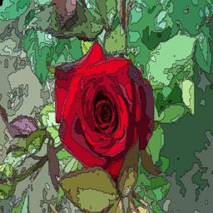
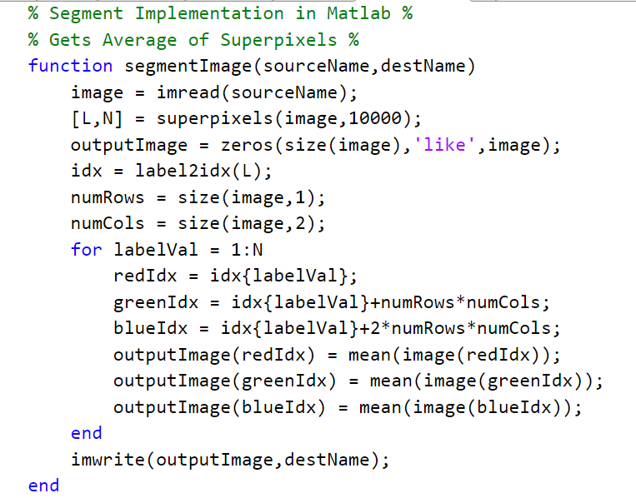
Image Segmentation in Matlab
50,000 Segmentations
Notes:
Add image of segmented Photo

Slide 10
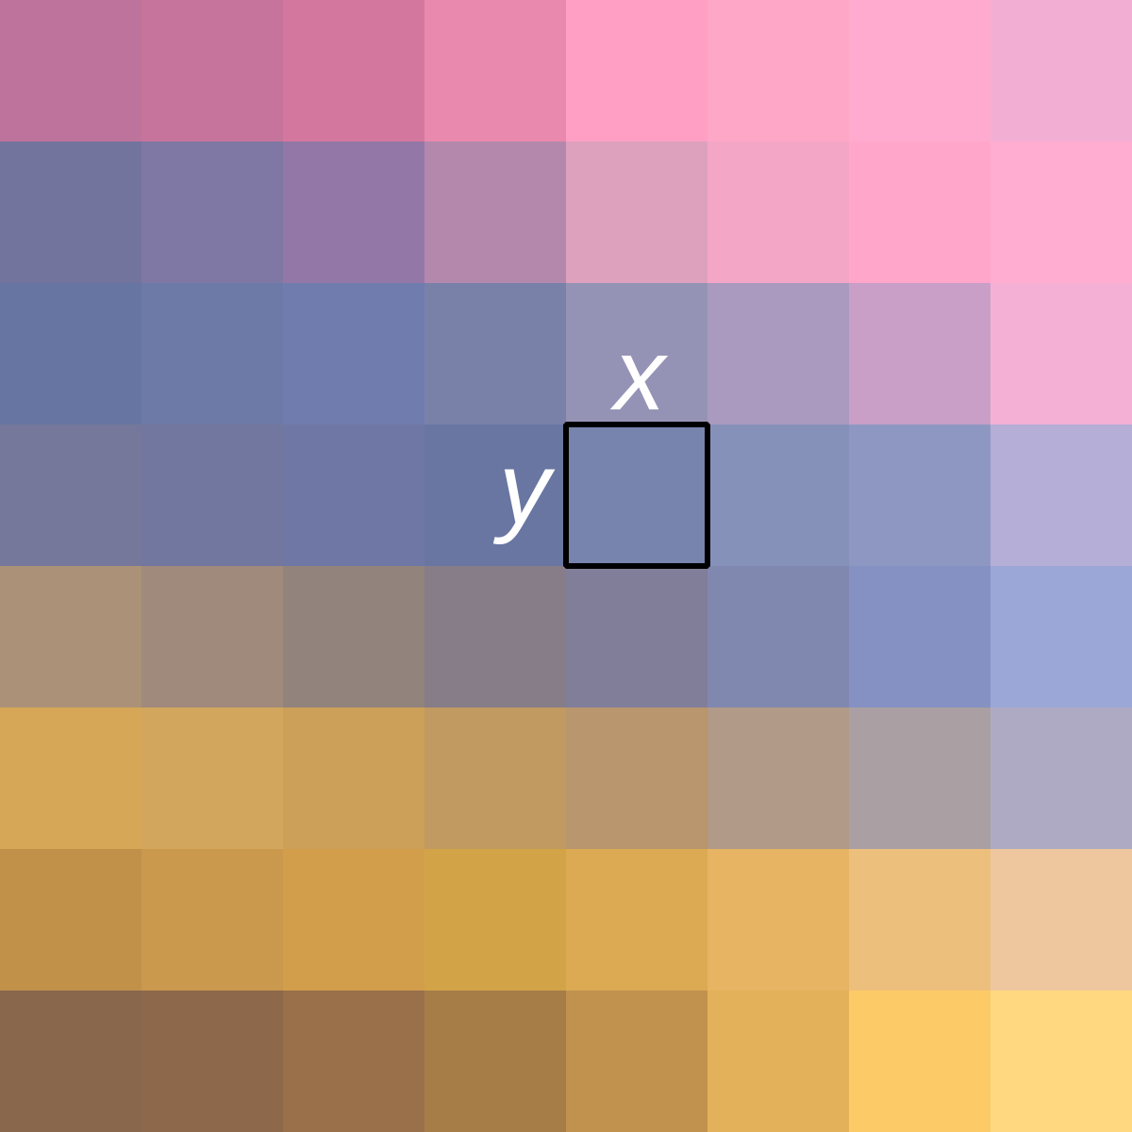
Segmentation, Images, Graphs
1
0,0 | 0,1 | 0,2 | 0,3
1,0 | 1,1 | 1,2 | 1,3
2,0 | 2,1 | 2,2 | 2,3
3,0 | 3,1 | 3,2 | 3,3
0,0 | 0,1 | 0,2 | 0,3
1,0 | 1,1 | 1,2 | 1,3
2,0 | 2,1 | 2,2 | 2,3
3,0 | 3,1 | 3,2 | 3,3
Images: 2 dimensional matrix from the pixel perspective.
Pixel: has 3 channels being RGB. Super Pixel: similar pixels and combining
2
3
Similar Pixels and How they are a network?
Each Pixel has 8 neighboring pixel. This creates 8 bi-directional edges. With this in mind we can create weights by segmenting the grouped pixels into 1 super pixel.
[6]

Slide 11
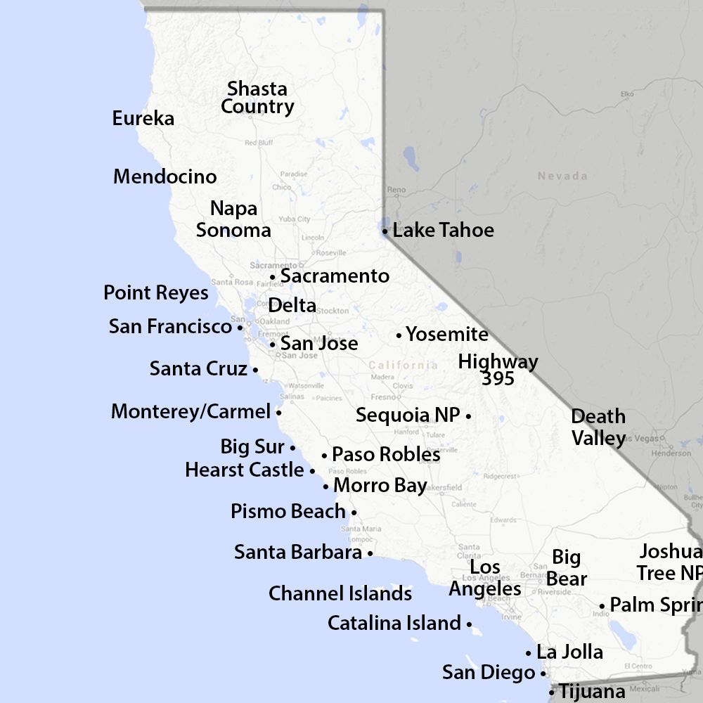
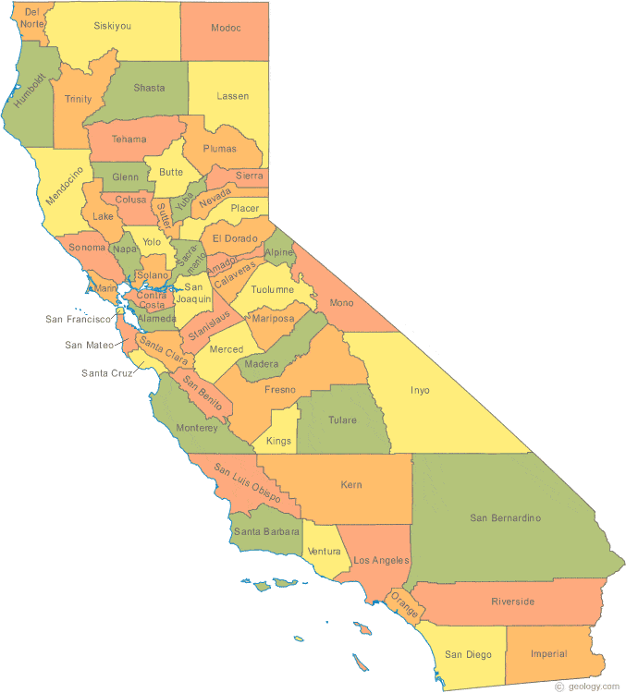
Map analogy
Group a pair of cities into what is known as a county.
This is done through many weights and measures such as population and natural boundaries (deserts,mountains, forest)
[8],[9]

Slide 12
Creating and Training the Model
02

Slide 13
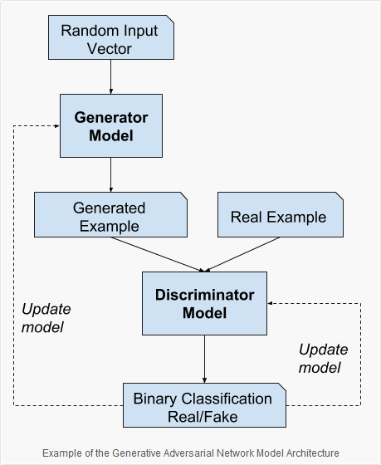
Overview of GAN
Generative Adversarial Networks
Unsupervised
Two parts
Generator
Goal is to “trick” discriminator
Discriminator
Goal is to pick the real example from the generated
Phases of training
[7]
Notes:
Generator
Takes a random distribution as input

Slide 14
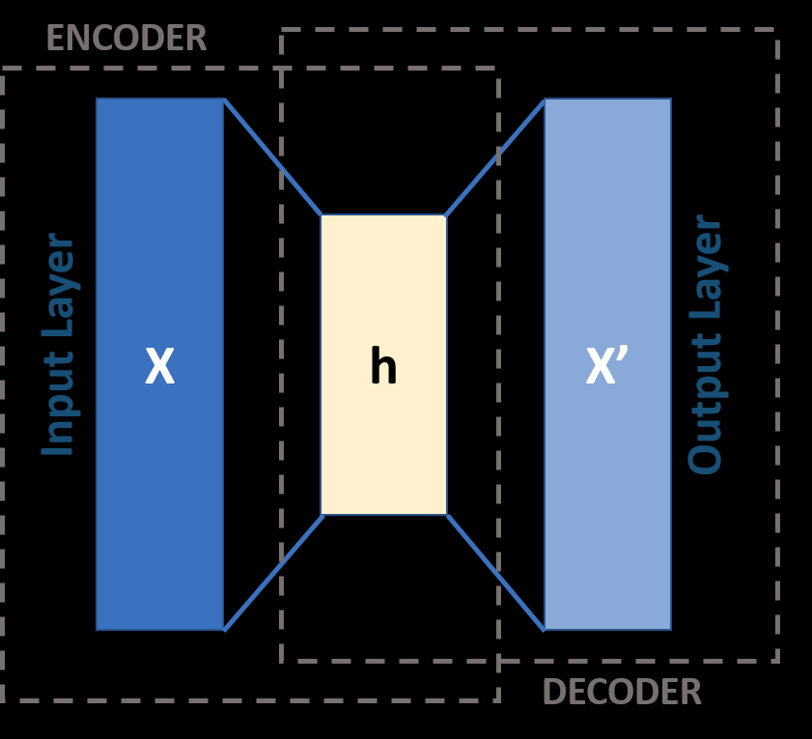
Overview of Autoencoder
Unsupervised
Performs dimensionality reduction of data
Excellent feature detectors
Very similar to MLP (multi-layer-perceptron)
Learns to copy inputs to outputs
Convolutional Layers
[5]

Slide 15
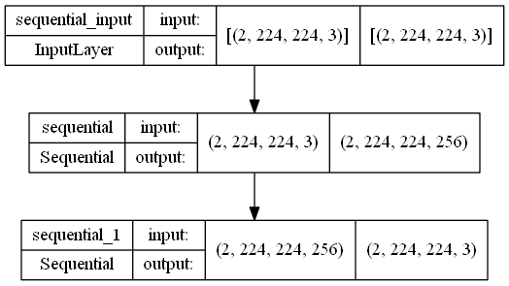
Our Autoencoder Architecture

Slide 16
Game Time! (Test of Plausibility)
Rules:
We will show 2 photos (separately)
One of the photos is real and the other is fake (the predicted one)
After showing both photos we will have you raise type in the chat if the first and second chat is real.

Slide 17
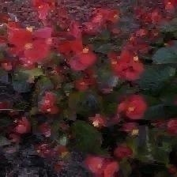
Demo: Real or Fake?

Slide 18
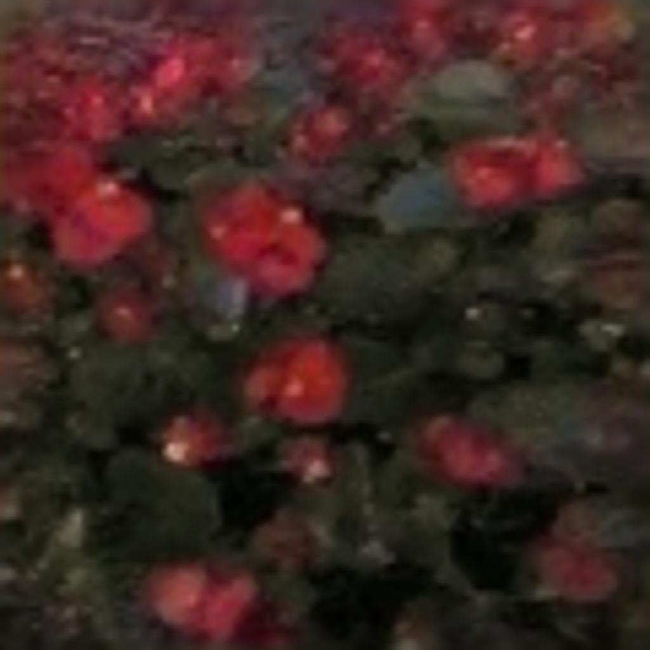
Demo: Real or Fake?

Slide 19
Demo: Real or Fake?
Real
Fake

Slide 20
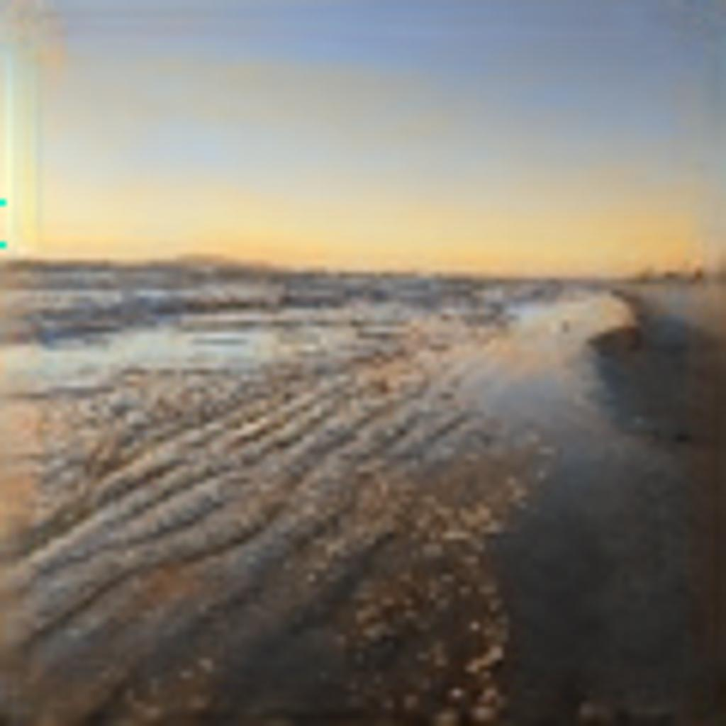
Round 2!

Slide 21
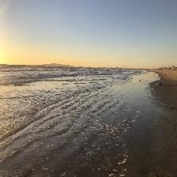
Round 2!

Slide 22
Round 2!
Fake
Real

Slide 23
Grading and Checking Results
03

Slide 24
Grading Algorithms
MAX Color Probability and RGB
GrayScale Average + Threshold
OPENCV GrayScale Average
Compares Max Color Channel for every pixel
Probability that the Neural Network can predict the max color channel for each pixel
Ie: Original RGB = (120,130,110)
Green Channel = Max(Original)
Predicted RGB = (110,140,105)
Green Channel = Max(Predicted)
In this example the AI successfully chose the MAX color channel
Generic GrayScale Formula: (R+G+B)/3
Segmented Image is compared pixel by pixel to see if the prediction was within the threshold range
Ie: Original RGB = (120,130,110)
Original Gray= (120)
Predicted RGB = (122,134,100)
Predicted Gray = (118.667)
120-Threshold < Predicted < 120+Threshold
OpenCV GrayScale Formula: (R*.30+G*.59+B*.11)
This is how OPENCV converts there GrayScale image. This is because each channel has natural different weights.
Works similarly to the other gray scale average. Just uses OPENCV formula combined with Threshold Value of our choice.

Slide 25
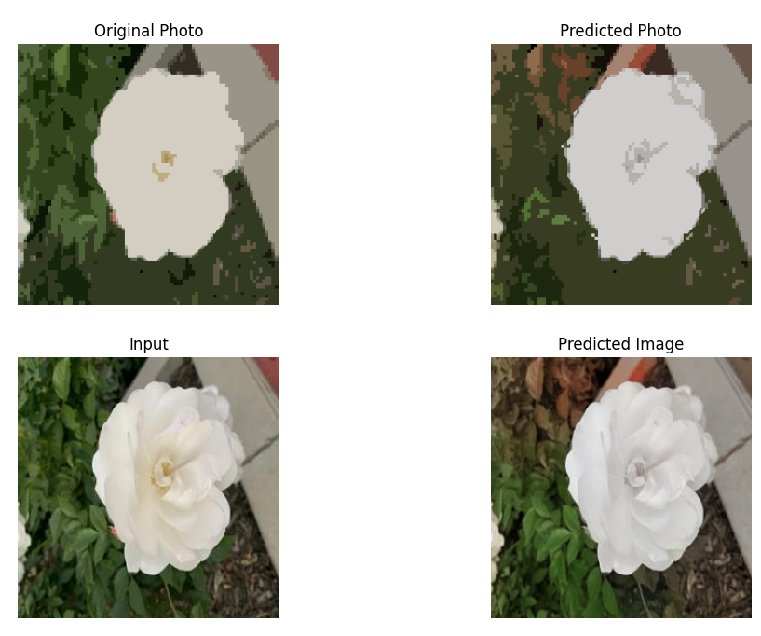
Model Accuracy (Grading Algorithm)
-------------------------------------------------------------------------------------------------
Max Color Probability: 0.904693603515625
Max Red Probability: 0.981817037875928 -> 31210/31788
Max Green Probability: 0.8362369337979094 -> 28080/33579
Max Blue Probability: 0.0 -> 0/172
GrayScale Met with Threshold: 0.842620849609375 Threshold: 20
GrayScale OPENCV comparison: 0.88720703125 Threshold: 20
-------------------------------------------------------------------------------------------------

Slide 26
Results
Richard Zhang AI
GAN AI (trained with our dataset)
Ours
Max Color Probability:
0.91
Max Red Probability:
0.98 -> 31210/31788
Max Green Probability:
0.84 -> 28080/33579
Max Blue Probability:
0.0 -> 0/172
GrayScale Met with Threshold: 0.84 Threshold: 20
GrayScale OPENCV comparison: 0.89 Threshold: 20
Max Color Probability:
0.49
Max Red Probability:
0.96 -> 30364/31788
Max Green Probability:
0.06 -> 1915/33579
Max Blue Probability:
0.05 -> 9/172
GrayScale Met with Threshold: 0.81 Threshold: 20
GrayScale OPENCV comparison: 0.91 Threshold: 20
ie(20 epochs)
Max Color Probability:
.01
Max Red Probability:
0.019 -> 30364/24492
Max Green Probability:
0.004 -> 110/25464
Max Blue Probability:
0.69 -> 156/223
GrayScale Met with Threshold: 0.64 Threshold: 20
GrayScale OPENCV comparison: 0.71 Threshold: 20

Slide 27
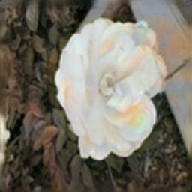
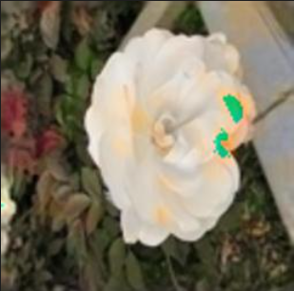
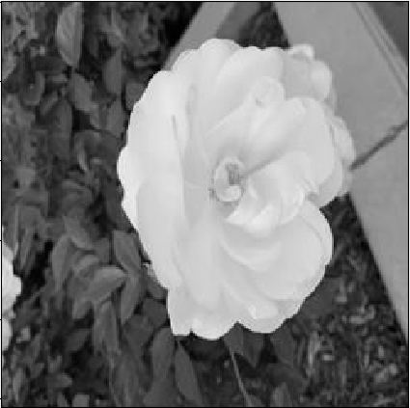
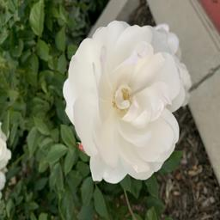
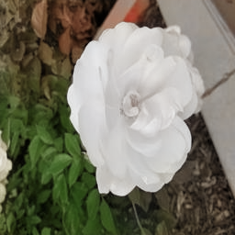
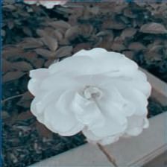
Input
Actual Image
GAN
91% GrayScale Accurate
49% Max Color Accurate
ECCV16
89% GS Accurate
91% Max Color Acc
Autoencoder
71% GrayScale Accurate
1% Max Color Accurate

Slide 28
Conclusion and Future Goals
For Image Colorization, we found that our GAN provided significant advantages over other contemporary solutions to the problem. A significant advantage in our method was the extreme accuracy achieved with relatively small training data, without the need to modify another model for feature extraction.
Future Work:
Old videos
De-noising using autoencoder
3d cloud point data and LIDAR
Notes:
In the future, we would be interested in applying our model to the problem of colorizing videos. Videos contain multiple frames that have correlation to each other which can be used to further improve the accuracy of the colorization model.
Additionally, our auto-encoder can be a multi-stage process which denoises the image in model prediction.
Colorization can be applied to 3D cloud point data for 3D modeling.

Slide 29
THANKS!
Please Email Us for Any Questions
timothd4@uci.edu
mprata@uci.edu
jragde@uci.edu
alexw12@uci.edu
Please keep this slide for attribution.

Slide 30
References
[1] Muzdakis, Madeleine. “Photo Restorer Colorizes Every Portrait of a President Who Was Photographed in Black and White [Interview].” My Modern Met, MY MODERN MET, 6 Nov. 2020, https://mymodernmet.com/james-berridge-colorized-presidential-portraits/.
[2] Levin, Anat & Lischinski, Dani & Weiss, Yair. (2004). Colorization using Optimization. ACM Transactions on Graphics. 23. 10.1145/1015706.1015780.
[3] Richard Zhang, Phillip Isola, and Alexei A. Efros. Colorful Image Colorization. 2016. arXiv: 1603.08511[cs.CV].
[4] Shravankumar Shetty. Image colorization. Oct. 2018. url: https://www.kaggle.com/shravankumar9892/image-colorization.
[5] Sobel, Paweł. “Autoencoder: Deep Learning Swiss Army Knife.” Digital Fingerprints, 11 Dec. 2020, https://fingerprints.digital/autoencoder-deep-learning-swiss-army-knife/.
[6]Suricata. “Pixel Aspect Ratio 1 to 1.” Jun. 2009, https://en.wikipedia.org/wiki/Pixel_aspect_ratio
[7] Brownlee, Jason. “A Gentle Introduction to Generative Adversarial Networks (Gans).” Machine Learning Mastery, 19 July 2019, https://machinelearningmastery.com/what-are-generative-adversarial-networks-gans/.
[8] Mallow, Betsy “California State Maps” 17 June. 2019, “https://www.tripsavvy.com/interactive-map-of-california-sights-1478372”
[9] WaterProof.com “California Counties” 2022, “https://californiathroughmylens.com/california-counties/”

